Slide 1
CamCrashCourse
ADITYA KAMATH–NNM22AM001
AISHIK ROY – NNM22AM002
AKANKSHA SALIAN–NNM22AM003
AMEYA G. KOWSHIK - NNM22AM004
AMSHA HEGDE - NNM22AM005

Slide 2
WELCOME TO camcrash course
IF YOU’RE NEW TO PHOTOGRAPHY YOU’VE COME TO THE RIGHT PLACE! WE OFFER A WIDE RANGE OF RESOURCES TO HELP YOU GET STARTED.

Slide 3
Introduction
What separates inspiring photographs from ordinary ones, and how can you improve the quality of your own work?
This introduction to photography is written for beginners, with several tips and suggestions to take your skills as far as possible. However, writing an introduction to photography is like writing an introduction to words; as amazing and important as it is, photography can be almost limitlessly complex.

Slide 4
What is photography?
Photography is the art of capturing light with a camera, usually via a digital sensor or film, to create an image. With the right camera equipment, you can even photograph wavelengths of light invisible to the human eye, including UV, infrared, and radio.
The first permanent photograph was captured in 1826 (some sources say 1827) by Joseph Nicéphore Niépce in France.
In photography, the technical and the creative go hand in hand.
Remember the Ansel Adams quote? “There is nothing worse than a sharp image of a fuzzy concept.” If the idea behind a photo is weak, using the right camera settings won’t make it better.

Slide 5
Do You Need a Fancy Camera?
Many people today believe that their phone is good enough for most photography, and they have no need to buy a separate camera. And you know what? They’re not wrong. For most people out there, a dedicated camera is overkill.
Phones are better than dedicated cameras for most people’s needs. They’re quicker and easier to use, not to mention their seamless integration with social media. It only makes sense to get a dedicated camera if your phone isn’t good enough for the photos you want (like photographing sports or low-light environments) or if you’re specifically interested in photography as a hobby.
That advice may sound crazy coming from a photographer, but it’s true. If you have any camera at all, especially a cell phone camera, you have what you need for photography. And if you have a more advanced camera, like a DSLR or mirrorless camera, what more is there to say? Your tools are up to the challenge. All that’s left is to learn how to use them.

Slide 6
What Is the Bare Minimum Gear Needed for Photography?
Camera. If you buy a dedicated camera pick one with interchangeable lenses so that you can try out different types of photography more easily.
Lenses. This is where it counts. For everyday photography, start with a standard zoom lens like a 24-70mm or 18-55mm. For portrait photography, pick a prime lens (one that doesn’t zoom) at 35mm, 50mm, or 85mm. For sports, go with a telephoto lens.
Post-processing software. One way or another, you need to edit your photos. The software that comes with your computer probably won’t cut it in the long run. But at the end of the day, Photoshop and Lightroom are still the standards for photo editing.

Slide 7
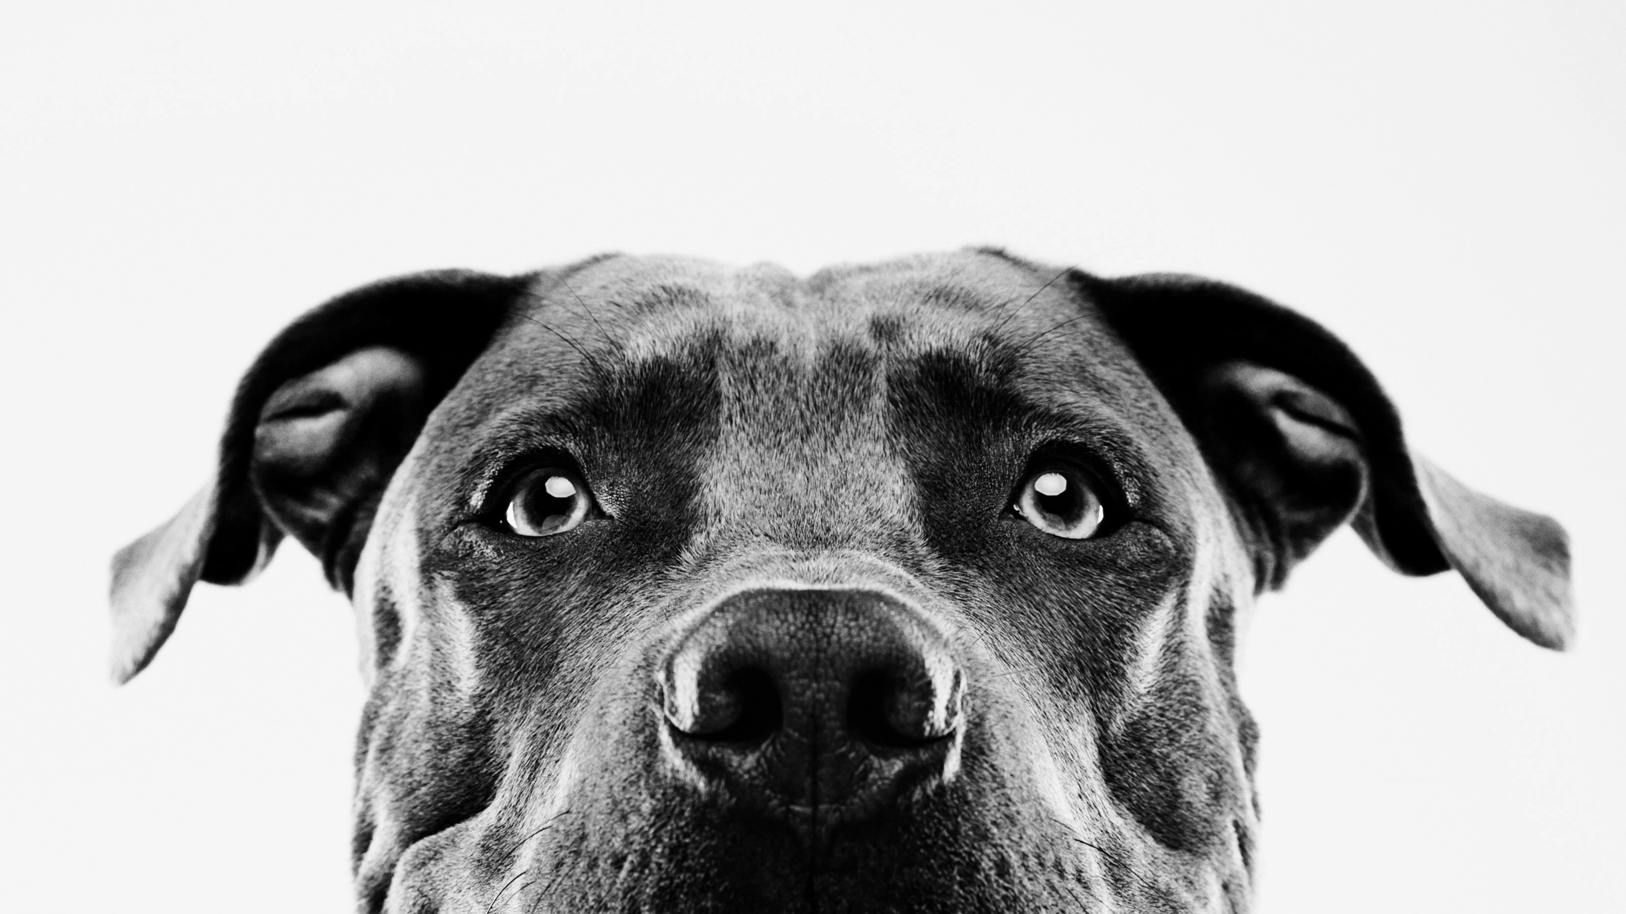
Photography Tips for Beginners

Slide 8
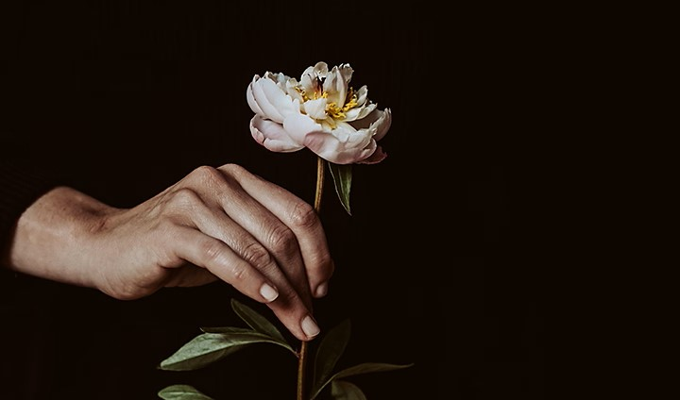
Work with your composition
Here are a few tips:
-To take engaging photos, you need to be engaged with what you’re doing. Don’t just fly by on autopilot. Instead, put thought into your composition and try to make your photos as good as possible.
- Focus on symmetry. It will tell you where the right angle is for the frame - Use natural frames such as windows, open doors, and curtains to make it look natural - Contrast is an excellent storyteller, and it is even better when used between the subject and the background - Keep both eyes on action and center the dominant eye. - Patterns are better when colliding. They enhance the aesthetic environment and the subject - Use diagonals for uneven locations. It will create geometry for you

Slide 9
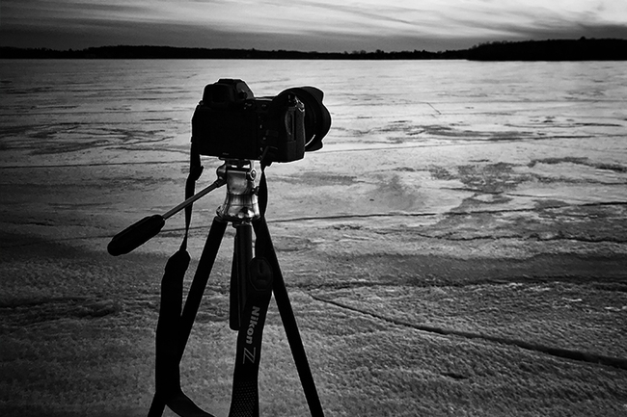
Use the camera you already have
There are countless cameras, lenses, and other accessories on the market today and it’s true that some are better than others. But the differences are almost always minor, especially at a given price. So, use the camera you already have, and don’t look back. In almost every way, today’s entry-level mirrorless cameras are better than the top-of-the-line film SLRs or even the DSLRs of ten years ago. Yet, somehow those film photographers managed to capture beautiful, iconic photos that still look great today. Much more important are your creative skills and knowledge of camera settings. Focus your effort on those, not on collecting camera equipment.

Slide 10
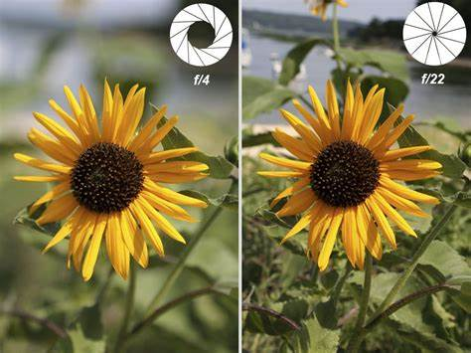
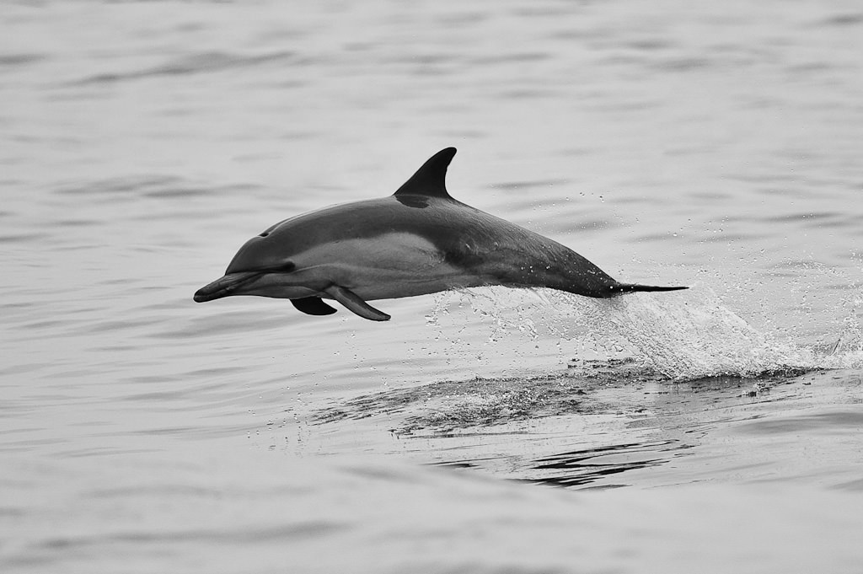
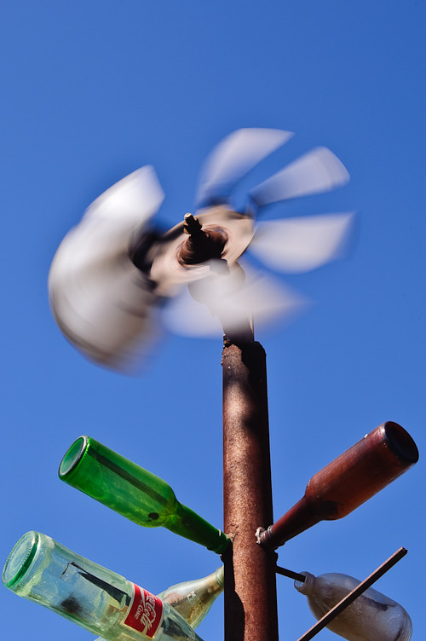
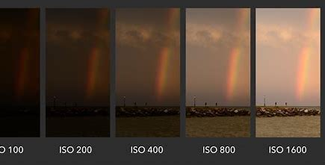
Learn which settings matter
Camera settings are an essential element of photography that you need to master. Exposure is the key to taking a great picture. Aperture, shutter speed, ISO combine to create an exposure. All three settings, when combined, control the amount of light reaching the sensor. Find the correct and appropriate balance of these settings before taking a picture. A clear understanding of the basic concept of aperture, shutter speed, and ISO helps you to apply these creatively in your journey ahead.
Aperture refers to the circular opening within your lens that lets in light. A wider aperture — f/1.8, for example — lets in more light. This means your camera performs better in low light and is able to capture a shallow depth of field. Choose a phone with a wide aperture (also referred to as a low f-stop number) for the most versatility.
Shutter speed is the length of time the camera shutter is open, exposing light onto the camera sensor. Essentially, it’s how long your camera spends taking a photo. This has a few important effects on how your images will appear. If your shutter speed is long, moving subjects in your photo will appear blurred along the direction of motion. In case of fast shutter speed, you can eliminate motion even from fast-moving objects, like birds in flight, or cars driving past.
ISO refers to your camera’s sensitivity to light. The higher the ISO, the more sensitive your camera sensor becomes, and the brighter your photos appear.ISO is measured in numbers. Here are a few standard ISO values: 100, 200, 400, 800, 1600, and 3200. ISO works alongside the two exposure variables – aperture and shutter speed – to determine the overall brightness level of an image.

Slide 11
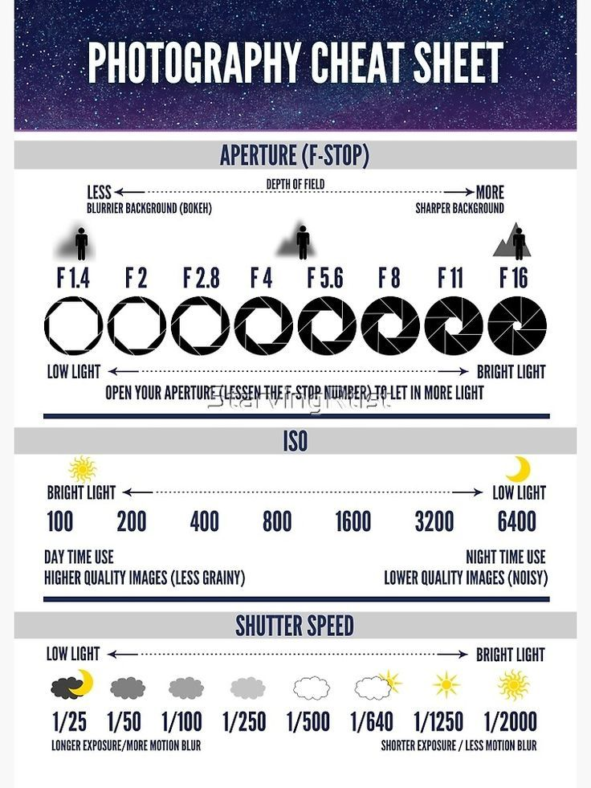
Clean The Lenses For Crystal Clear Photos
Set The Focus To Ensure Your Subject Is Always Sharp
Adjust Exposure For Perfect Brightness Levels
Use HDR For Evenly-Lit Photos With Amazing Detail
Shoot In Portrait Mode To Create Gorgeous Blurred Backgrounds
Activate Burst Mode For Incredible Action Shots
Switch Between iPhone Lenses To Zoom In Or Out
.Keep Your Camera Steady For Sharp, Shake-Free Shots
Use The Rule Of Thirds To Compose Beautiful Mobile Photos
Use Leading Lines For Powerful Images With Incredible Depth
Experiment With Different Perspectives For More Unique Images
Simplify Your Compositions For The Most Striking Shots

Slide 12
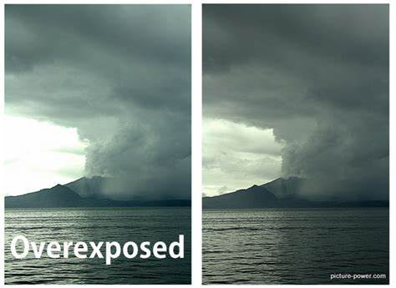
Don’t overexpose highlight
When you are picking your camera settings, it is critical to avoid overexposing highlights in a photo. It’s simply impossible to recover any detail from the white areas of a photo.
It’s pretty easy to keep your highlights intact. But this is where shutter speed, aperture, and ISO are so important. These are the only camera settings that directly affect the brightness of a photo (other than flash setting).

Slide 13
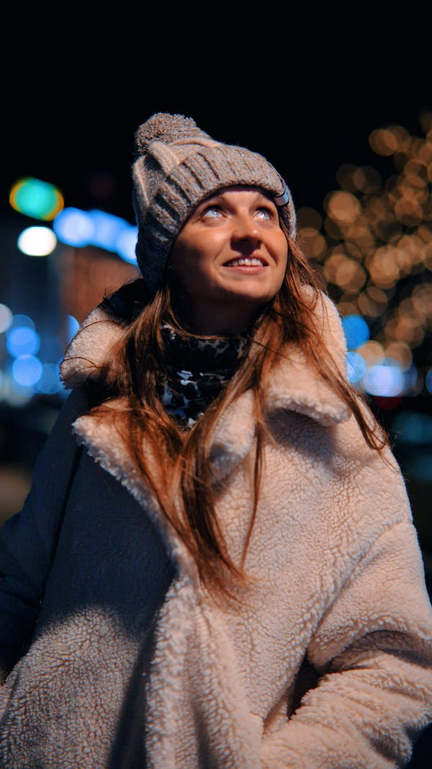
Pay attention to the light
The source of light for photography can either be natural or man-made. Different moods and atmospheres can be created for capturing shots as per the photographer’s imagination. These are the four main categories of light:
Natural Lighting
If you wish to capture a shot in natural light, you must have a clear understanding of the angle of the Sun and its prospective effects on the picture composition. Since natural lighting is softer than a Front Lighting
Front lighting
if you place the light source directly in front of your subject and not at an angle, the result can be a limited amount of shadows. This lighting technique can be used to click amazing portraits because the light spreads evenly across the photograph.
Transmitted Lighting
Using transmitted light and white background is a great technique to bring out as many colors as possible. Translucent subjects such as leaves, flowers, and feathers are best shot with this lighting technique.
Low Lighting Without Flash
In low lighting, your camera might have trouble focusing on the subject. If you find it difficult to get a sharp focus owing to the low light conditions, look for areas where there is a little more contrast. An enhanced contrast makes it easier for the camera to focus on the subject.

Slide 14
Take Your Time
It’s easy to make mistakes in photography if you aren’t careful. The best way around this is to slow down and take your time whenever possible, particularly when you are first beginning to learn photography.
First, double-check your camera settings. If you’re shooting outdoor portraits on a sunny day, but you’re using last night’s settings for photographing the Milky Way, something is terribly wrong. Slow down and take the time to get it right. Then, keep the same mindset for every other important decision like
Is your composition as good as possible?
Did you autofocus in the right place?
Have you done everything possible to improve the lighting conditions?
.

Slide 15
